Slide 1
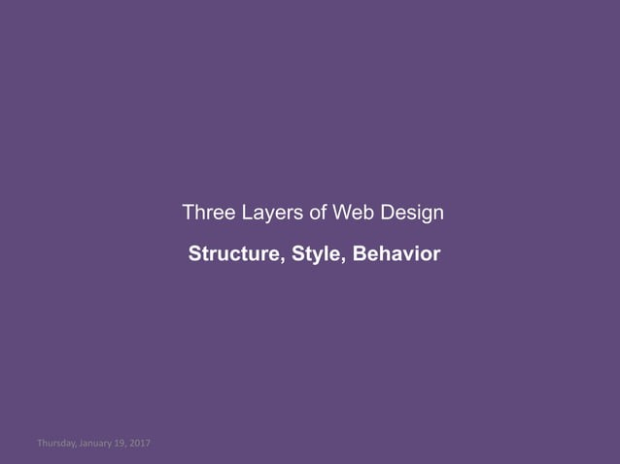

Slide 2
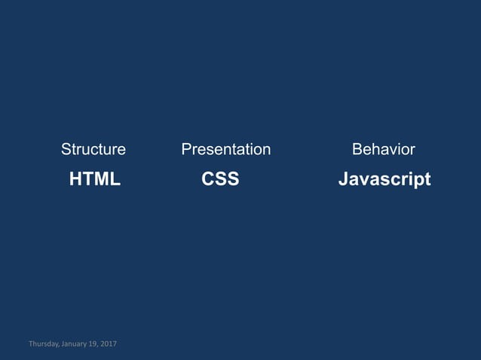

Slide 3
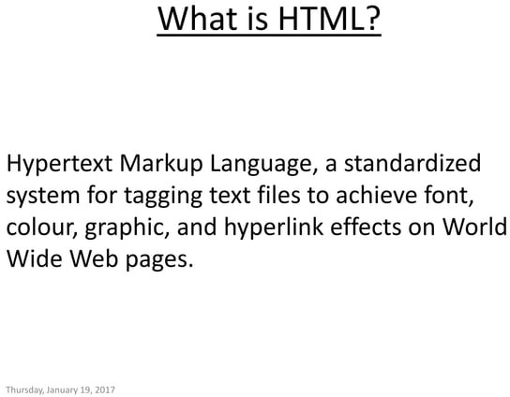

Slide 4
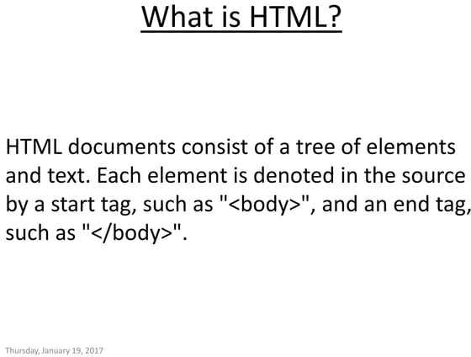

Slide 5
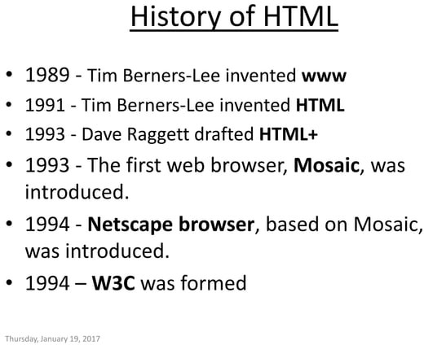

Slide 6
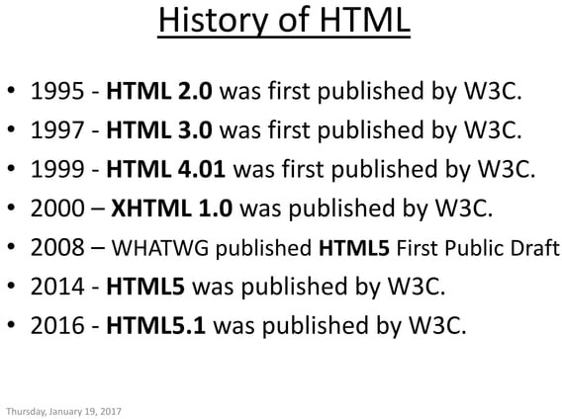

Slide 7
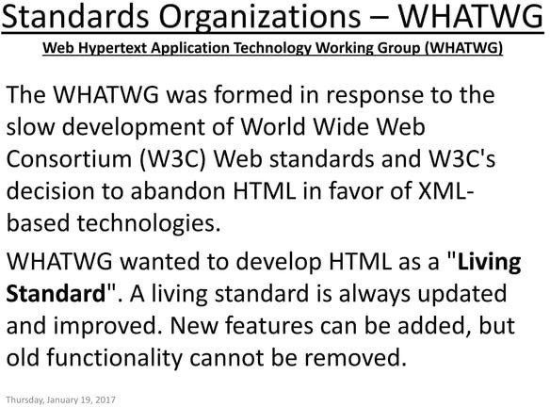

Slide 8
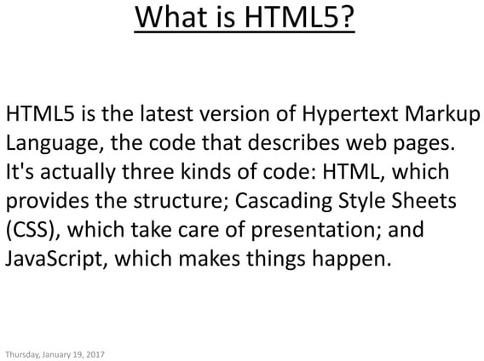

Slide 9
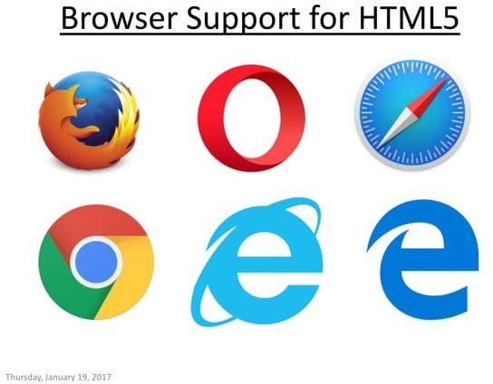

Slide 10
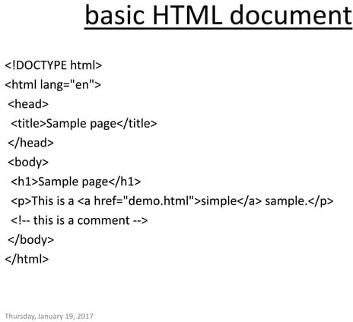

Slide 11
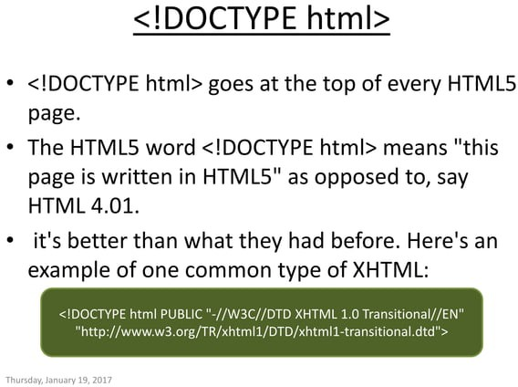

Slide 12
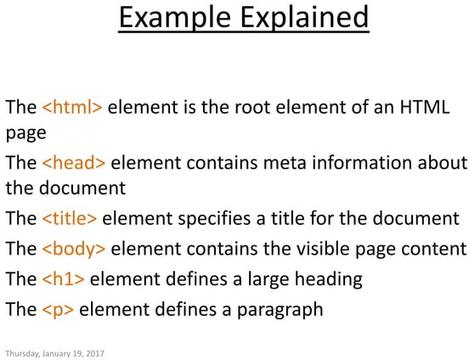

Slide 13
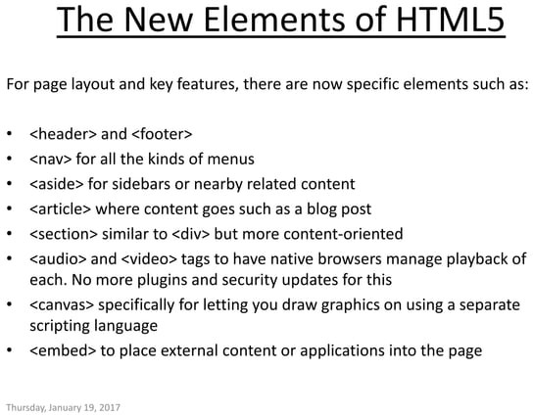

Slide 14
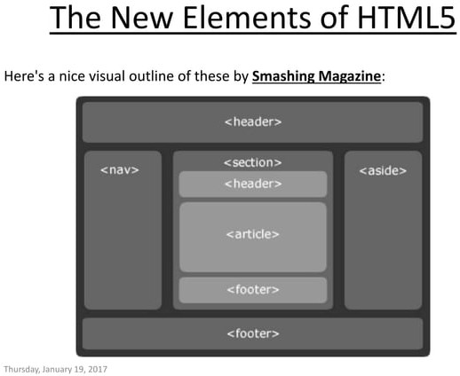

Slide 15
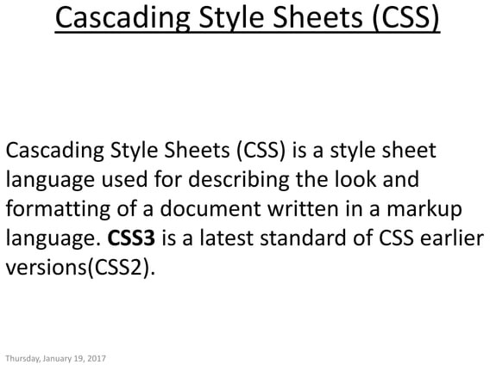

Slide 16
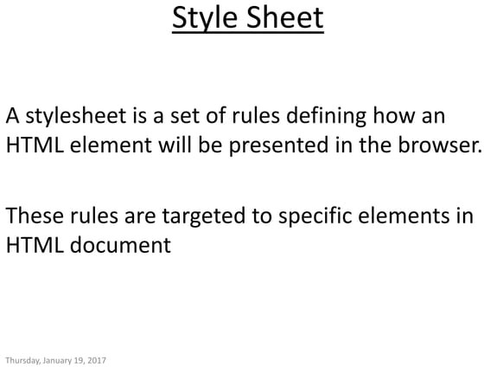

Slide 17
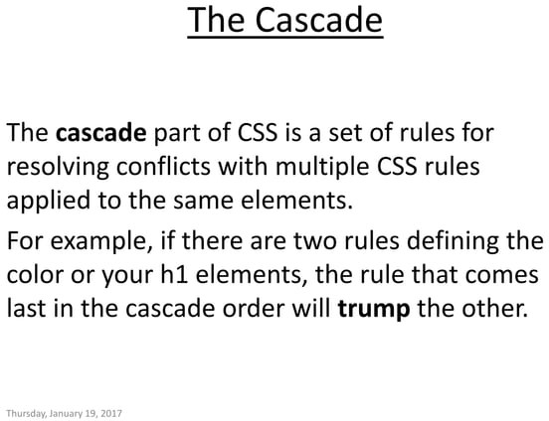

Slide 18
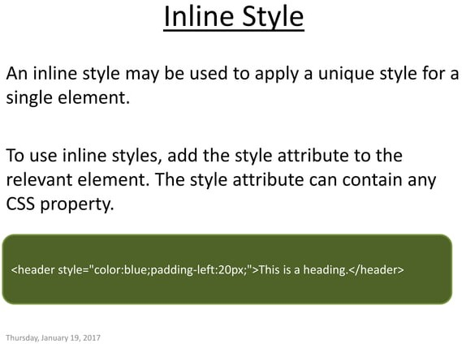

Slide 19
Inline Stylesheet
<!DOCTYPE html>
<html>
<body>
<h1 style="color:blue;text-align: center;">This is a heading</h1>
<p style="color:red;">This is a paragraph.</p>
<h1> Without Style</h1>
</body>
</html>

Slide 20
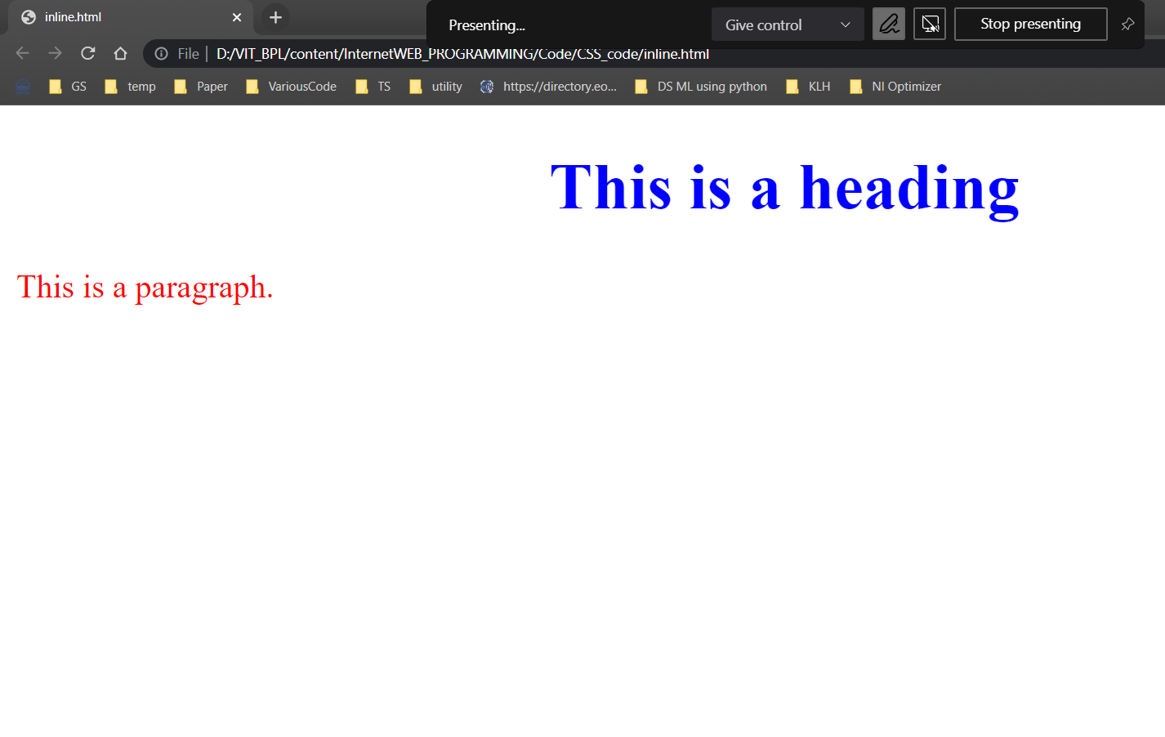

Slide 21
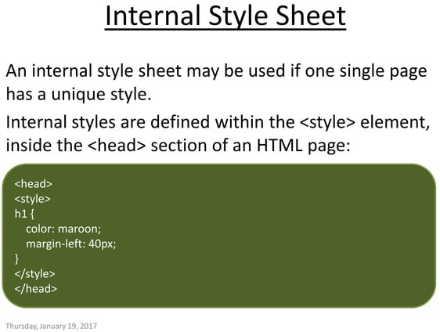

Slide 22
<!DOCTYPE html>
<html>
<head>
<style>
body {
background-color: linen;
}
h1 {
color: maroon;
margin-left: 40px;
}
p {
color: green;
margin-left: 20px;
}
</style>
</head>
<body>
<h1>This is a heading</h1>
<p>This is a paragraph.</p>
<h1>This is another heading</h1>
</body>
</html>

Slide 23
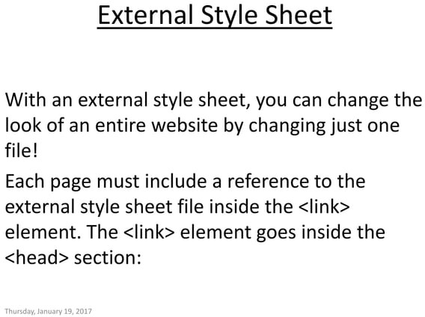

Slide 24
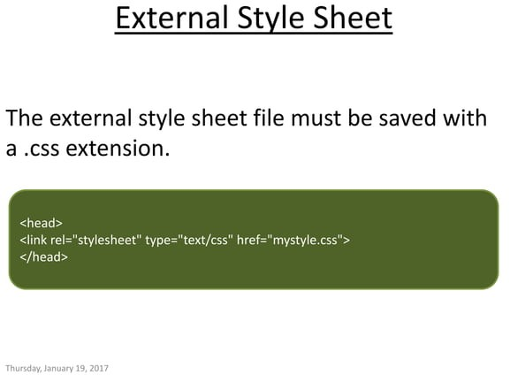

Slide 25
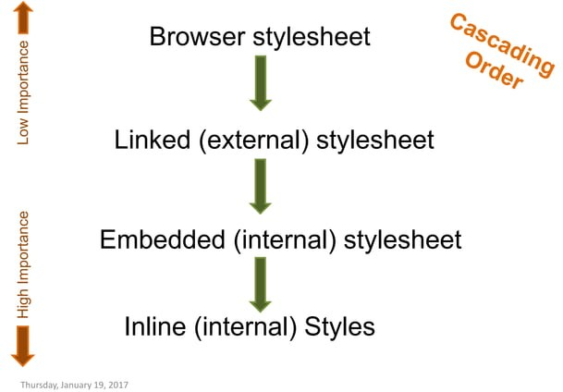

Slide 26
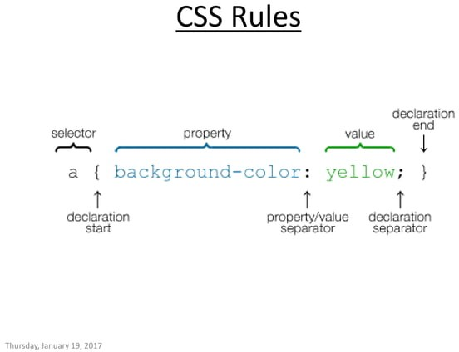

Slide 27
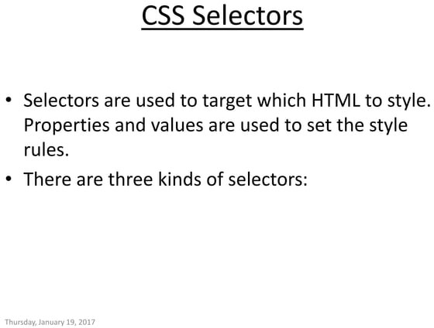

Slide 28
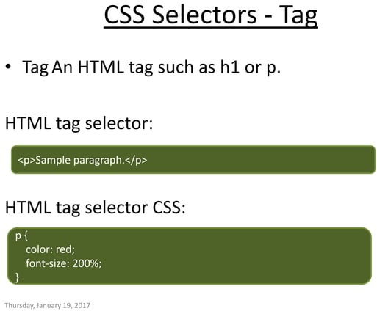

Slide 29
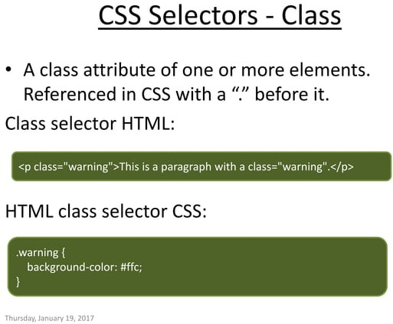

Slide 30
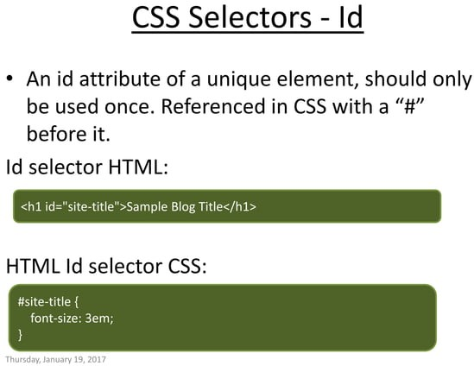

Slide 31
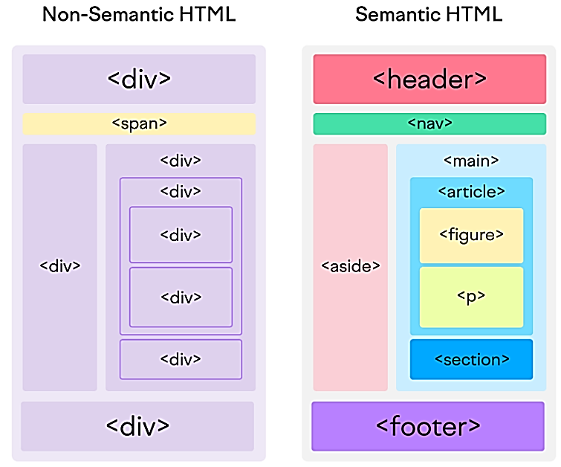
Semantic VS Non Semantic HTML
Semantic HTML, also known as semantic markup, refers to the use of HTML tags that convey the meaning—or semantics—of the content contained within them. By adding semantic HTML tags to your pages, you provide additional information that helps define the roles and relative importance of the different parts of your page. (As opposed to non-semantic HTML, which uses tags that don’t directly convey meaning.)

Slide 32
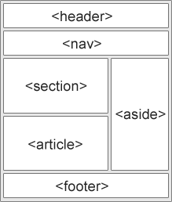
HTML Layout Elements
HTML has several semantic elements that define the different parts of a web page:
<header> - Defines a header for a document or a section <nav> - Defines a set of navigation links <section> - Defines a section in a document <article> - Defines an independent, self-contained content <aside> - Defines content aside from the content (like a sidebar) <footer> - Defines a footer for a document or a section

Slide 33
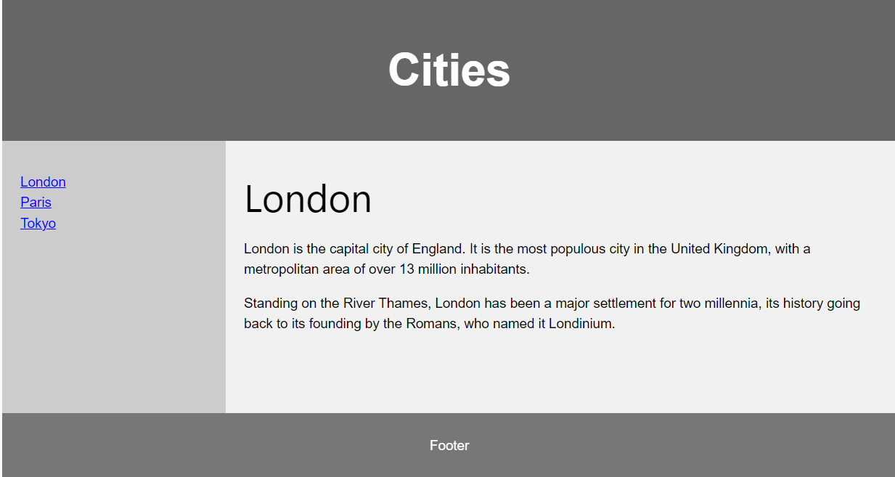
HTML Layout Example

Slide 34
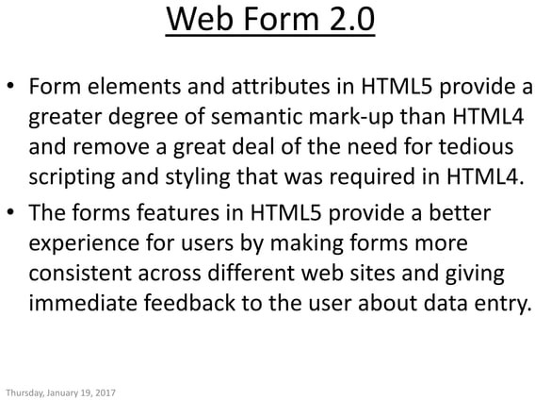

Slide 35
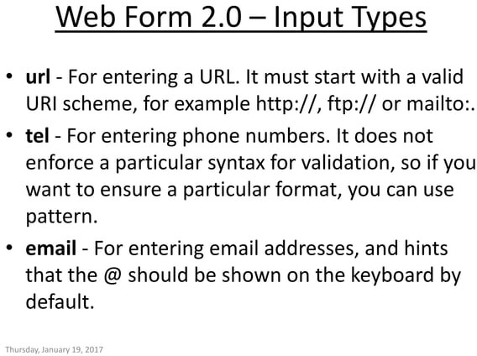

Slide 36
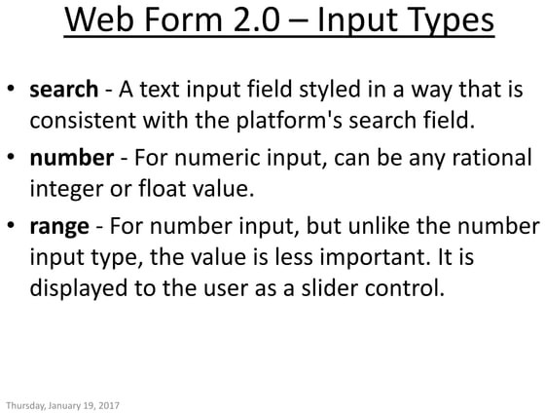

Slide 37
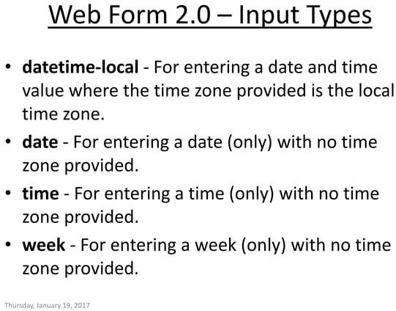

Slide 38
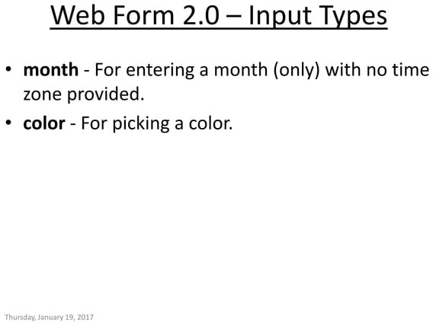

Slide 39
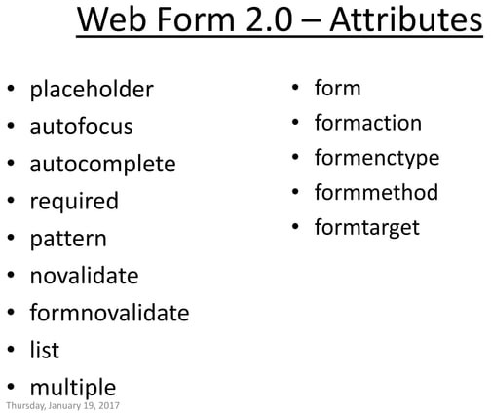

Slide 40
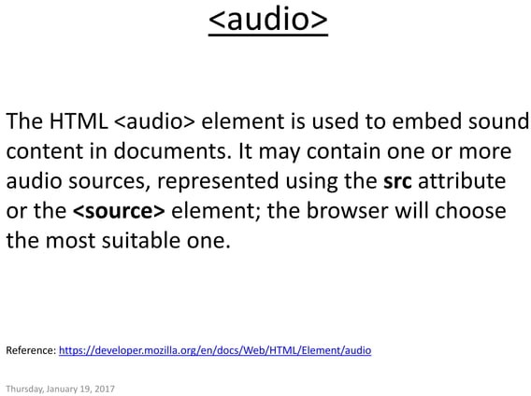

Slide 41
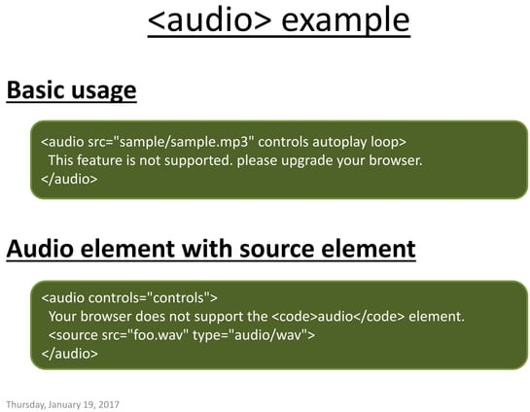

Slide 42
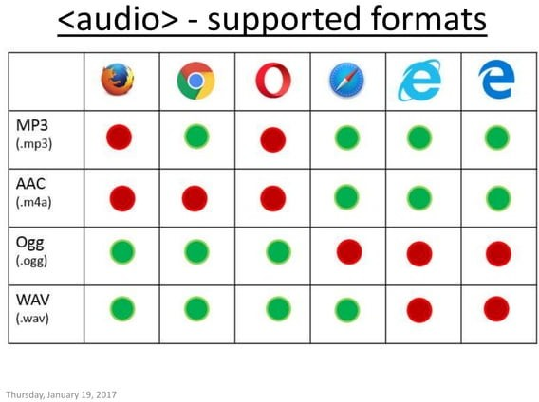

Slide 43
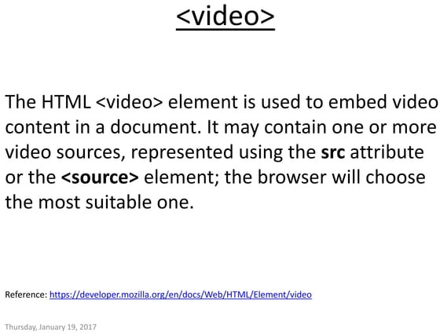

Slide 44
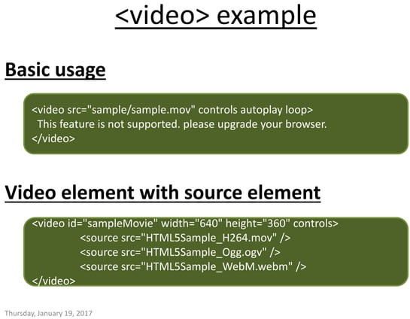

Slide 45
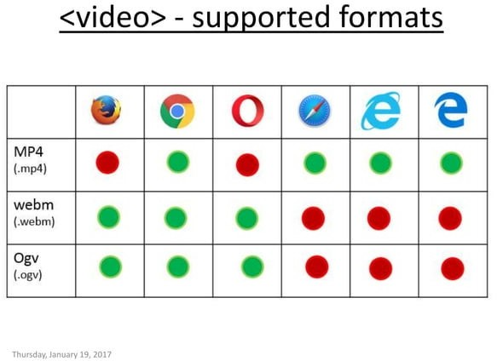

Slide 46
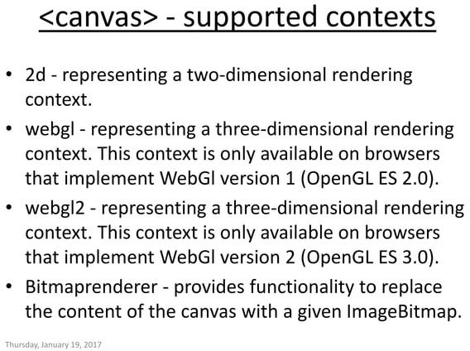

Slide 47
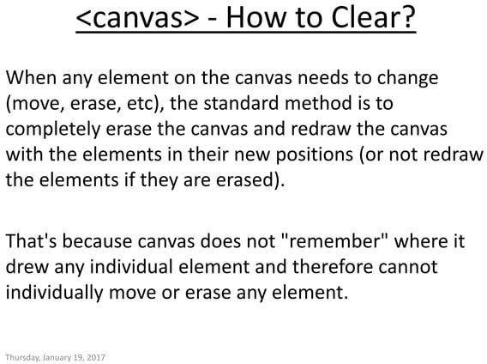

Slide 48
